Slide 1
Arduino + LwMesh Network with WM-100 & KITRFA1
Gerson Fernando Budke
nandojve@gmail.com

Slide 2
Agenda
Overview
Installing Tools
Setup Environment
Testing tools (Blink a LED)
LwMesh (Energy Scan Demo)
LwMesh (Peer-to-Peer Blink a LED)
LwMesh (Peer-to-Peer UART)
LwMesh (Wireless Sensor Network Demo WSNDemo)
Issues?

Slide 3
Overview
The hands on target is provide basic knowledge to use LwMesh Network with KITRFA1 and WM-100-Duino kits. To do this the user will follow a series of steps like:
  Install tools that compile and download firmware into board.
  Setup of Arduino IDE environment to use the tools correctly.
  Compile, Download and Run Demos.

Slide 4
Installing Tools
Install ATMEL Studio 6
  go to http://www.atmel.com/tools/atmelstudio.aspx and download a full version of ATMEL Studio 6 (with .NET)
  Now, the basic environment have ALL devices configurations.
Install AVRxPROG
  go to https://github.com/nandojve/AVRxPROG and download last version of AVRxPROG.
  Now, the firmware can be download to board by console or any high level application. Look the basic steps at:
    cd <avrxprog install dir>
    avrxprog <enter>

Slide 5
Installing Tools
Install Java 6 run time software
  go to http://www.oracle.com/technetwork/java/javase/downloads/index.html and download last java jre version
  This is need by Arduino IDE
Install Arduino IDE
  create a folder and called Arduino
  go to https://github.com/nandojve/Arduino/release and download last version of Arduino IDE. Put the download into that folder! This is a fork of Arduino IDE v1.05 that uses AVRxPROG and have full version of LwMesh network library ported to Arduino.
  extract all content

Slide 6
Installing Tools
Download Hercules Utility
  go to http://www.hw-group.com/products/hercules/index_en.html and download last version
  First run, accept license
Install board drivers
  go to https://github.com/nandojve/hardware
  Open <board>/driver folder and download content
  WM-100-DUINO:
    Board: WM – Wireless Modules
    Driver: WM Series (Wireless Module CDC Driver)

Slide 7
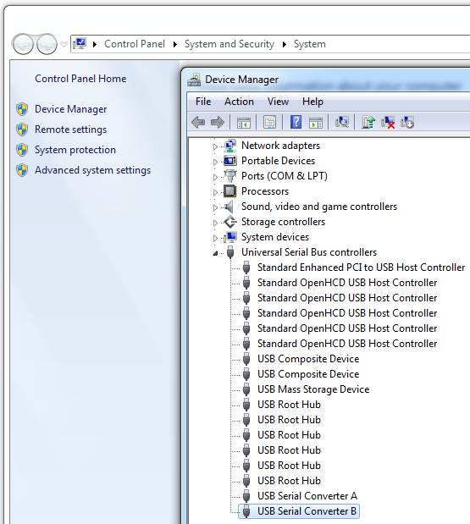
Setup Environment
Setup second KITRFA1 COM port
  Open Control Panel ->
  System and Security ->
  System ->
  USB controllers ->
  Select USB Serial Converter B ->
  Properties

Slide 8
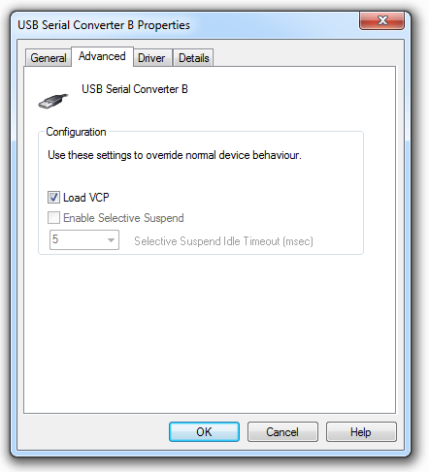
Setup Environment
  Load VCP driver
  Press OK
  Now, 2° port will install and show up

Slide 9
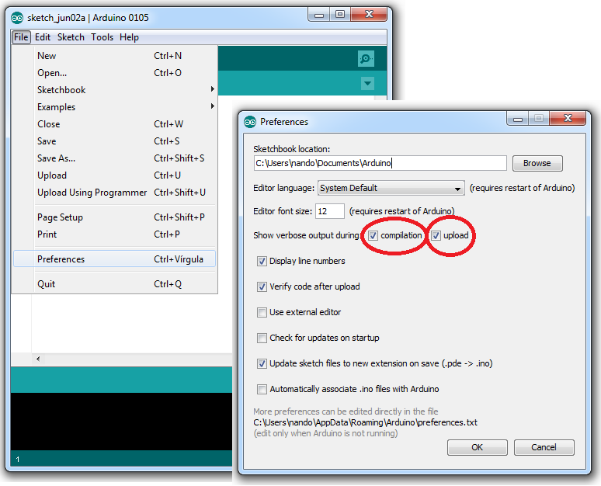
Setup Environment
Arduino
  Set Preferences

Slide 10
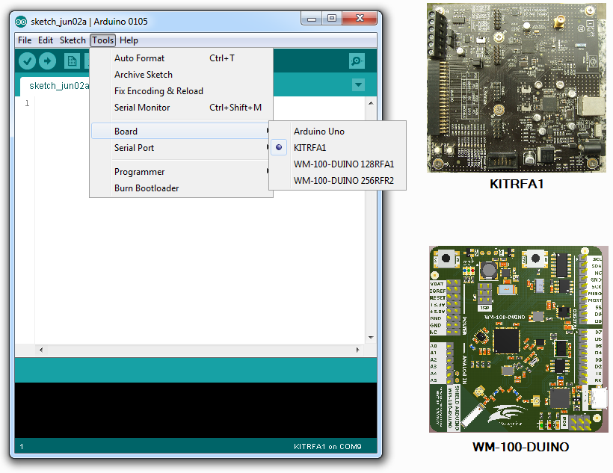
Setup Environment
  Set Board

Slide 11
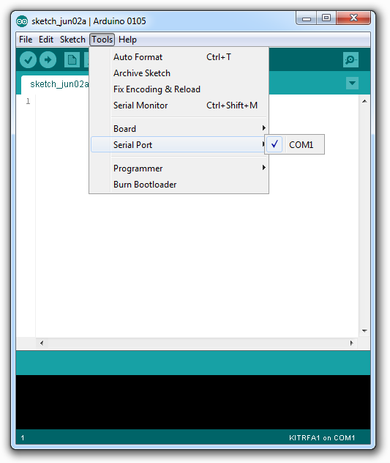
Setup Environment
  Set COM Port

Slide 12
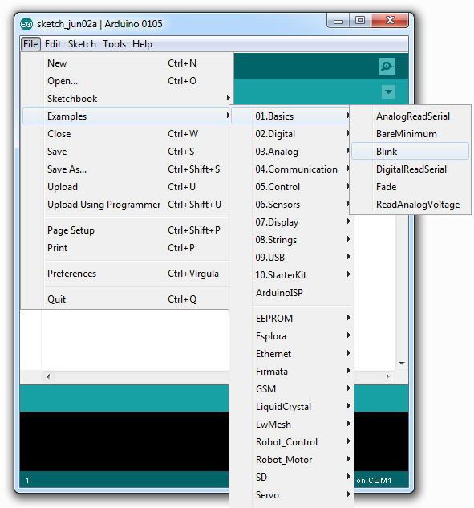
Testing tools (Blink a LED)
New Blink example
Close other Arduino IDE
Save (CTRL+S)

Slide 13
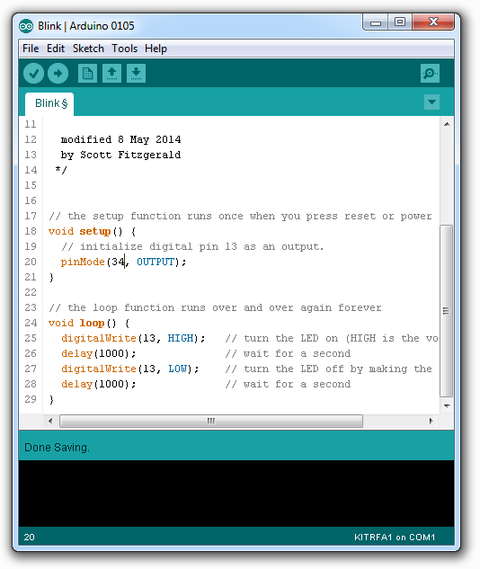
Testing tools (Blink a LED)
Change pinMode:
  34 – KITRFA1
  24 – WM-100-DUINO
Save

Slide 14
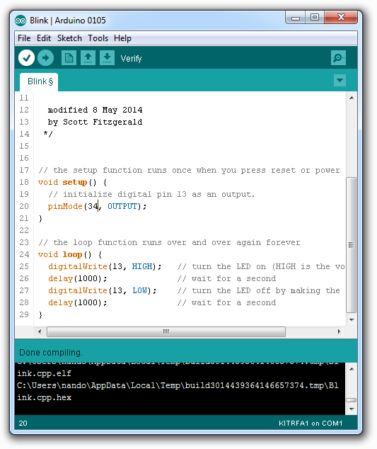
Testing tools (Blink a LED)
Compile (Arduino Verify)

Slide 15
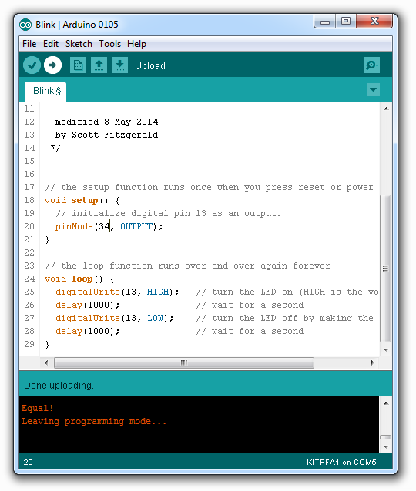
Testing tools (Blink a LED)
Upload (Setup KIT)
  KITRFA1:
    Power Off kit
    Press SWITCH key
    Power On kit
    LED 3 blink 5 times
    (auto) Kit waiting AVRxPROG
    (auto) AVRxPROG exit bootloader
    (auto) Led blink 5 times
    (auto) bootloader run application
  WM-100-DUINO
    Press Reset key (S1)
    Press DFU key (S2)
    Release S1
    LED 0 blink 5 times
    Release S2
    (auto) idem KITRFA1
Upload (Arduino Upload)

Slide 16
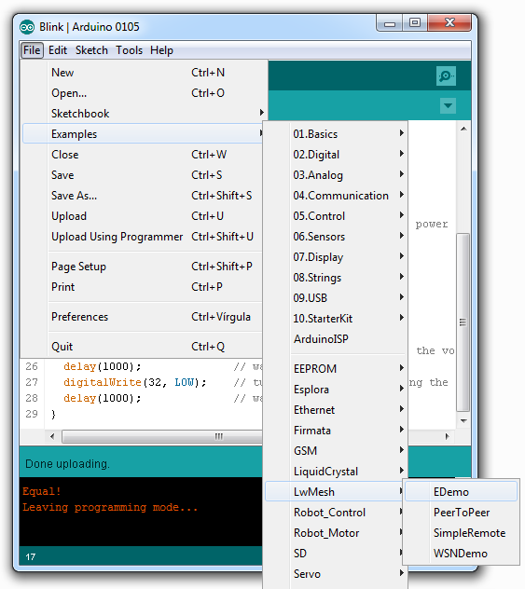
LwMesh (Energy Scan Demo)
New EDdemo
Save

Slide 17
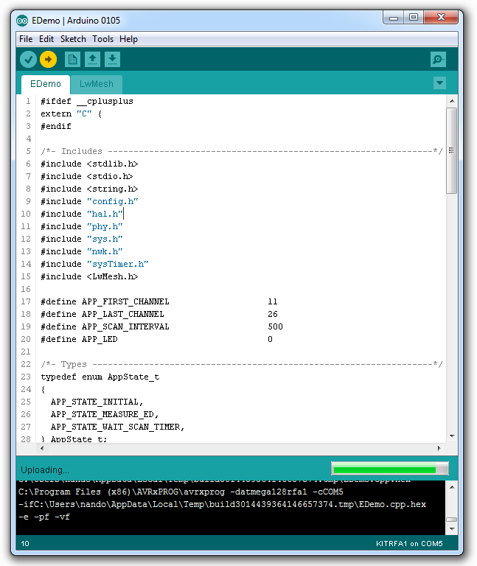
LwMesh (Energy Scan Demo)
EDemo.ino have sample code
LwMesh.ino have:
  basic LwMesh object use
  setup and loop code
More details of LwMesh:
  <Arduino>/libraries/LwMesh/doc
Prepare to AVRxPROG
Upload demo

Slide 18
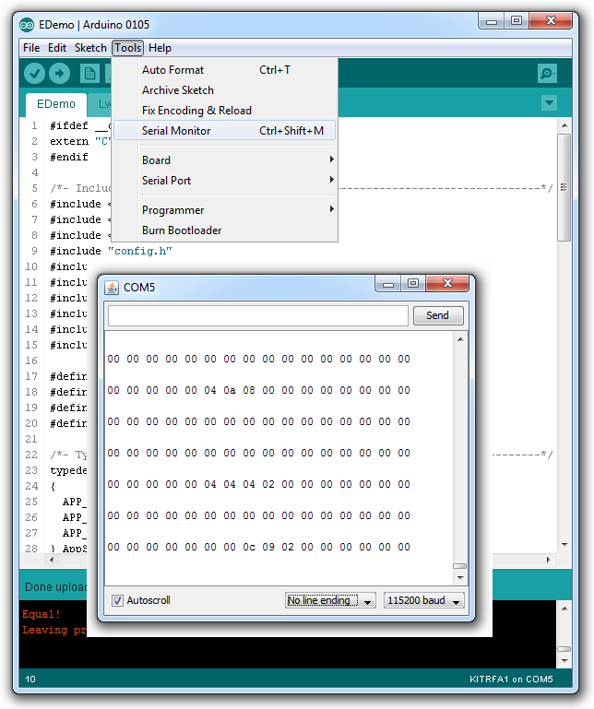
LwMesh (Energy Scan Demo)
Open serial monitor at 115200 kbit
Demo show:
  Line by line power of channels
  Any line show channel 11 to 26

Slide 19
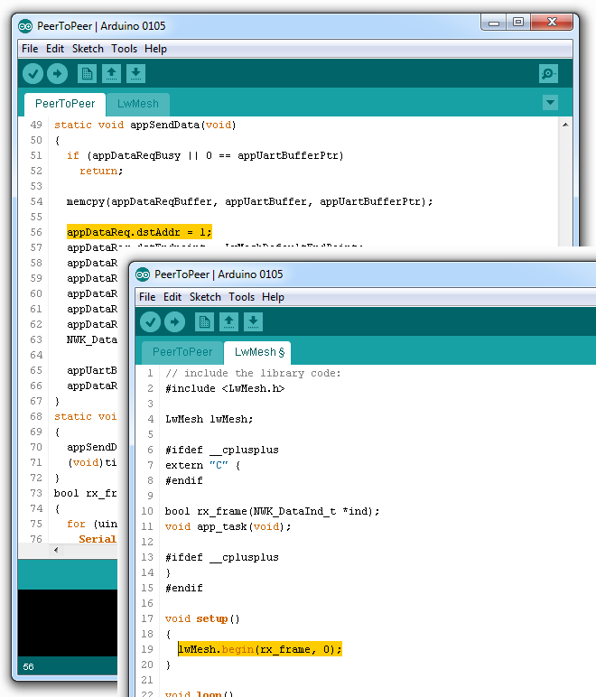
LwMesh (Peer-to-Peer Blink a LED)
New SimpleRemote
Save
Setup boards:
  Board 1:
    Set appDataReq.dstAddr = 1;
    Set lwMesh.begin(rx_frame, 0);
    Save
    Upload
  Board 2:
    Set appDataReq.dstAddr = 0;
    Set lwMesh.begin(rx_frame, 1);
    Save
    Upload
Press SWITCH/DFU key to blink led

Slide 20
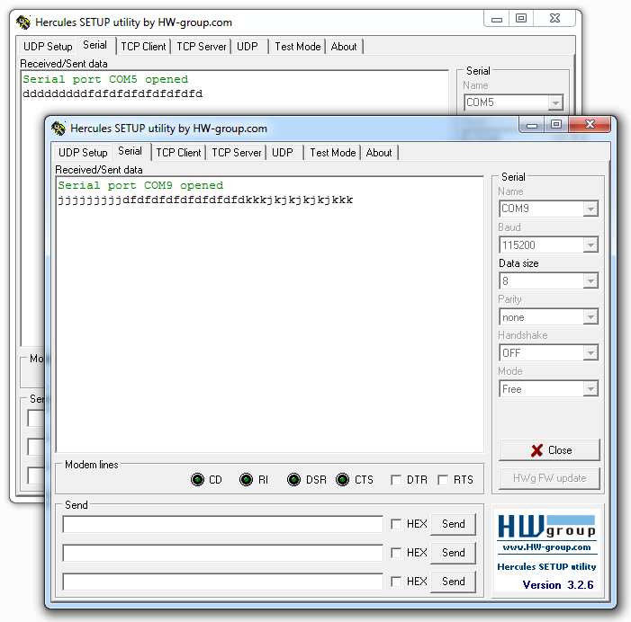
LwMesh (Peer-to-Peer UART)
New PeerToPeer
Save
Setup boards like (SimpleRemote)
Open two Hercules Console
  First, open with board 1
  Second, open with board 2
  Both at 115200 kbps

Slide 21
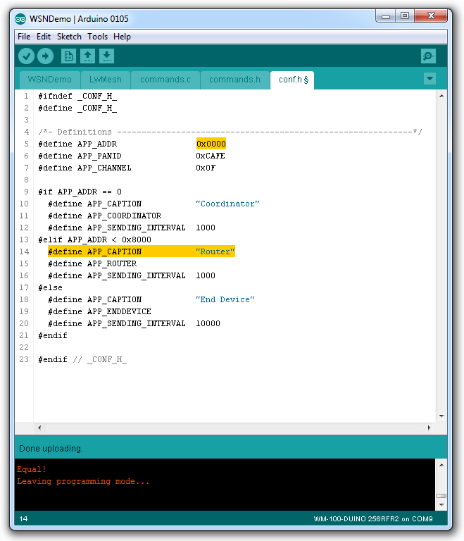
LwMesh (Wireless Sensor Network Demo WSNDemo)
New WSNDemo
Save
Setup board in conf.h
  Set APP_ADDR given by instructor
  Set APP_CAPTION with your name
Upload
Look at WSNMonitor your name!

Slide 22
Issues?
nandojve at gmail dot com

